Slide 1


ANALYSIS
By Jitendra Kumar Singh

Slide 2
Data Description
You have access to the required data and data dictionaries in the form of CSV files.
The Reviews dataset (Reviews.csv) encompasses details regarding reviews submitted for Airbnb listings, while the Listings dataset (Listings.csv) comprehensively captures all pertinent information about the listed accommodations. In-depth descriptions of each column are provided in their corresponding data dictionary files (Listings_data_dictionary.csv and Reviews_data_dictionary.csv)

Slide 3
Business objective
Our main goal is to conduct a thorough analysis of Airbnb data, unveiling valuable insights into user experiences and satisfaction levels across the diverse range of listed accommodations. This analysis will be executed using Power BI to enhance the presentation and interpretation of the findings.

Slide 4
Goals
1
Assessing District Location Scores:
2
Examining Host Response Time Impact:
3
Visualizing Airbnb Listing Prices:
4
Analyzing Composite Scores:
5
Calculating Listing Age and Host Tenure:
6
Property Type Price Analysis:
7
Crafting a Comprehensive City Insights Report:

Slide 5
Data Cleaning
Adjusted the Score Rating by dividing it with 10 for a standardized representation.
Updated instances of blanks in the 'host_since' column with the date 01-01-2022.
Filled in missing values in the 'host_response_time' column with "a few days or later".
Replaced all blank entries in the 'Review Score' with 0 for consistency.
Introduced a new column to compute the average of all Review Scores.
Implemented the following Measures:
Count of Hosts with 10 years of experience.
Count of Bookings.
Count of Customers.
Count of Hosts.
Count of Listings.
Average Cleanliness Score.
Average Accuracy Score.

Slide 6
Data Cleaning
Calculated and established the Average Cleanliness Score.
Computed the Average Accuracy Score.
Derived the Average Checkin Score.
Evaluated the Average Communication Score.
Analyzed the Average Location Score.
Determined the Average Price.
Calculated the Average Rating Score.
Assessed the Average Value Score.
Established the overall Average Score.
Introduced a new column denoting Hosting Tenure.
Identified hosts with a 10-year tenure through the creation of the Is 10 yrs Tenure column.

Slide 7

DASHBOARD

Slide 8
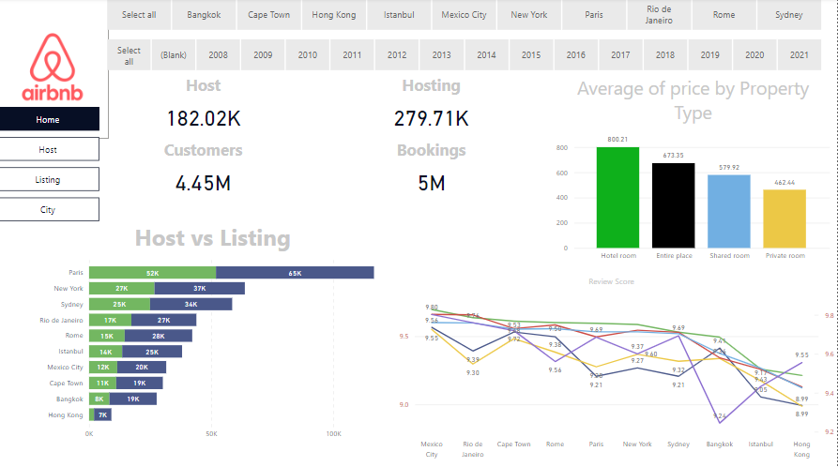

Slide 9
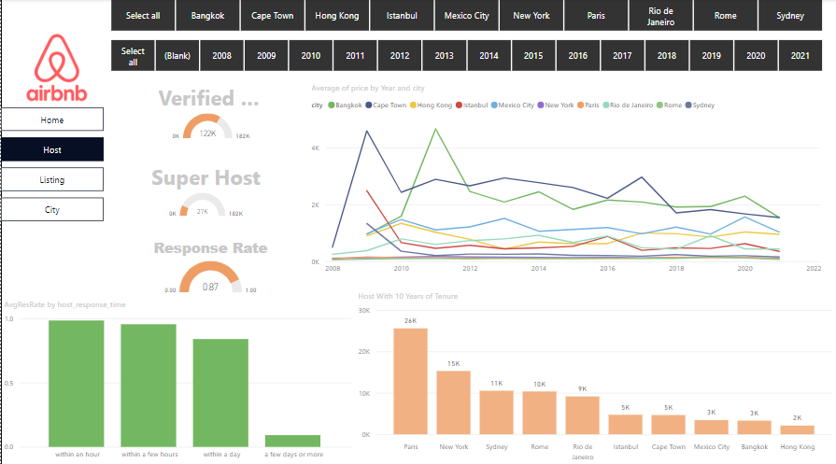

Slide 10
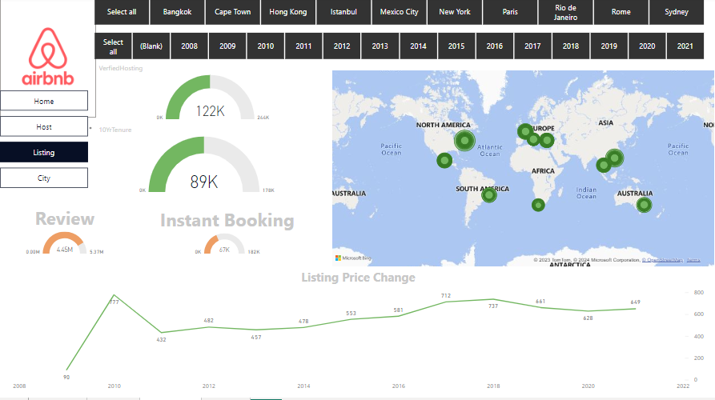

Slide 11
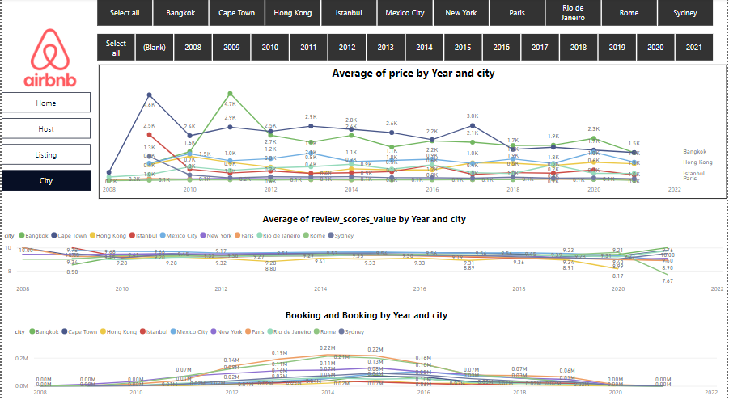

Slide 12


Thank
you!
JITENDRA KUMAR SINGH

